Slide 1
Photomicrographs of Plant foods
Arugula
Permission to reproduce original photomicrographs used to make this collection may be obtained from
Dr. David O. Norris
david.norris@colorado.edu

Slide 2
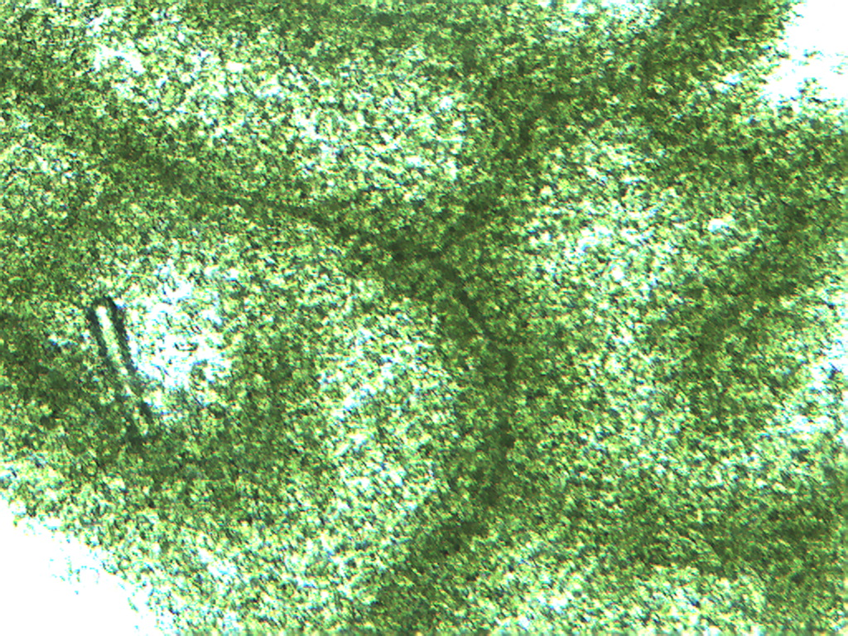
Notes:
16. Eruca vesicaria (L.) Arugula, leaf surface showing vascular pattern, 4X. Note vein pattern.

Slide 3
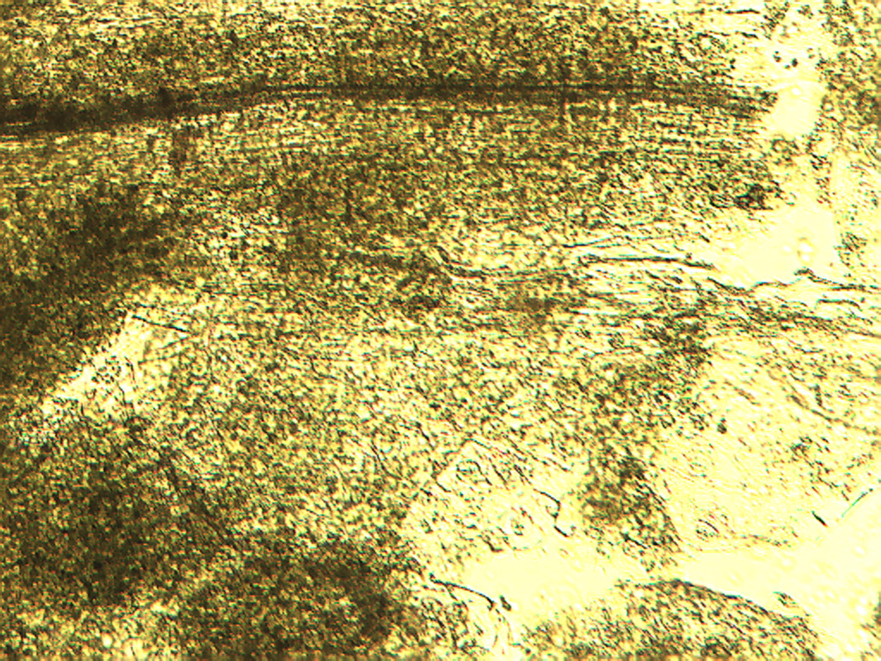
Notes:
17. Arugula. Leaf surface, 10X. Note vascular vein (between arrows)

Slide 4
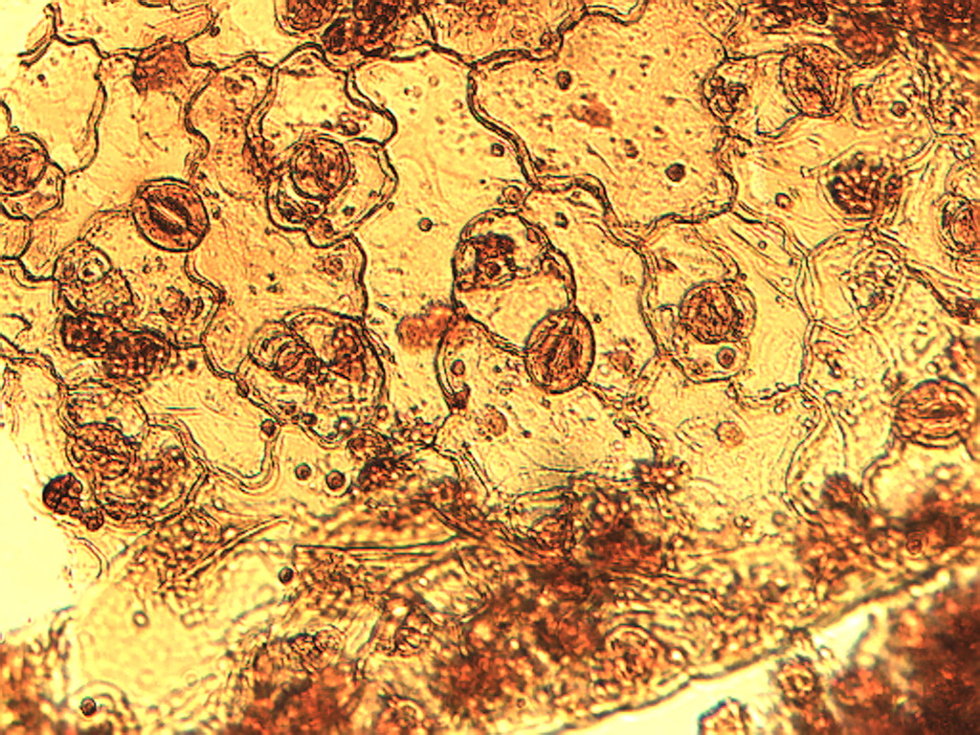
Notes:
18. Arugula. Epidermis of leaf, stained with safranin, 25X. Note stomata (arrows)

Slide 5
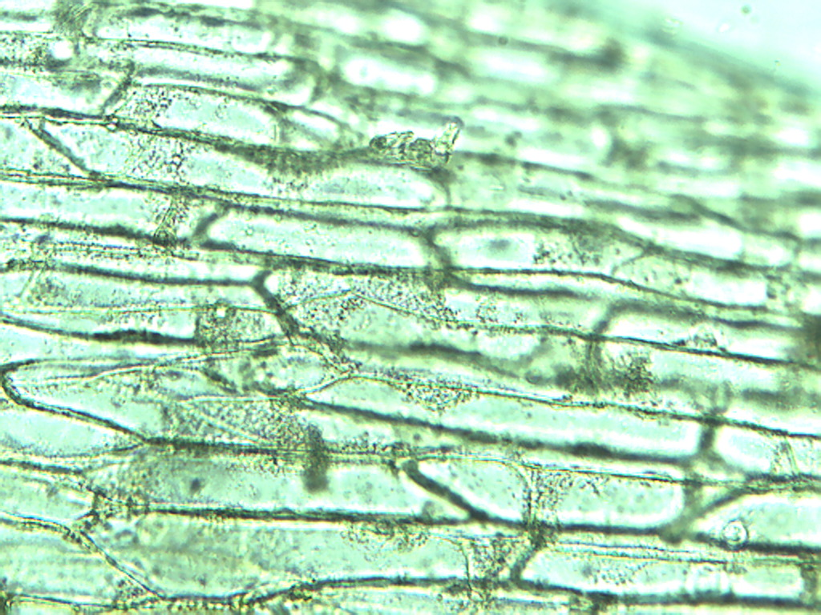
Notes:
19. Asparagus. Epidermal cells, 25X

